Slide 1




Board Meeting
February 5, 2019
Welcome Board & Friends!
Our Founding Partners
Notes:
In Attendance:
Madie Brown*
Anne Pressley
Alice Gilchrist
Sylvia Martin
Tom Peters
Michael Nelson
Terry Pruitt*
Angie Omer
Regina Wragg*
John Tully
Tracey Campbell
Donna Foster*
Gary Senn
John Don
*denoted board member

Slide 2
Our Intended Agenda
11:00 am Meet & Greet
11:30 Lunch
12:30 pm Welcomes/Celebrations
12:50 Community Engagement
1:00 Grand Challenges
1:15 STEM Ecosystems
2:15 SCCMS Misc.
1:55 Ways for you to Engage
2:45 ish Optional Tour
Notes:
This was our agenda. We sort of stuck to it and finished on time.

Slide 3
Welcome From The Arts Center of Greenwood
Notes:
Sylvia Martin, Education & Outreach at the Arts Center of Greenwood and Alice Gilchrist, S2TEM Centers SC Regional Coordinator gave us information about the upcoming iMAGINE STEAM Festival (March 16th) in uptown Greenwood.
Thanks Sylvia and Alice for arranging the meeting to be at the Arts Center.

Slide 4
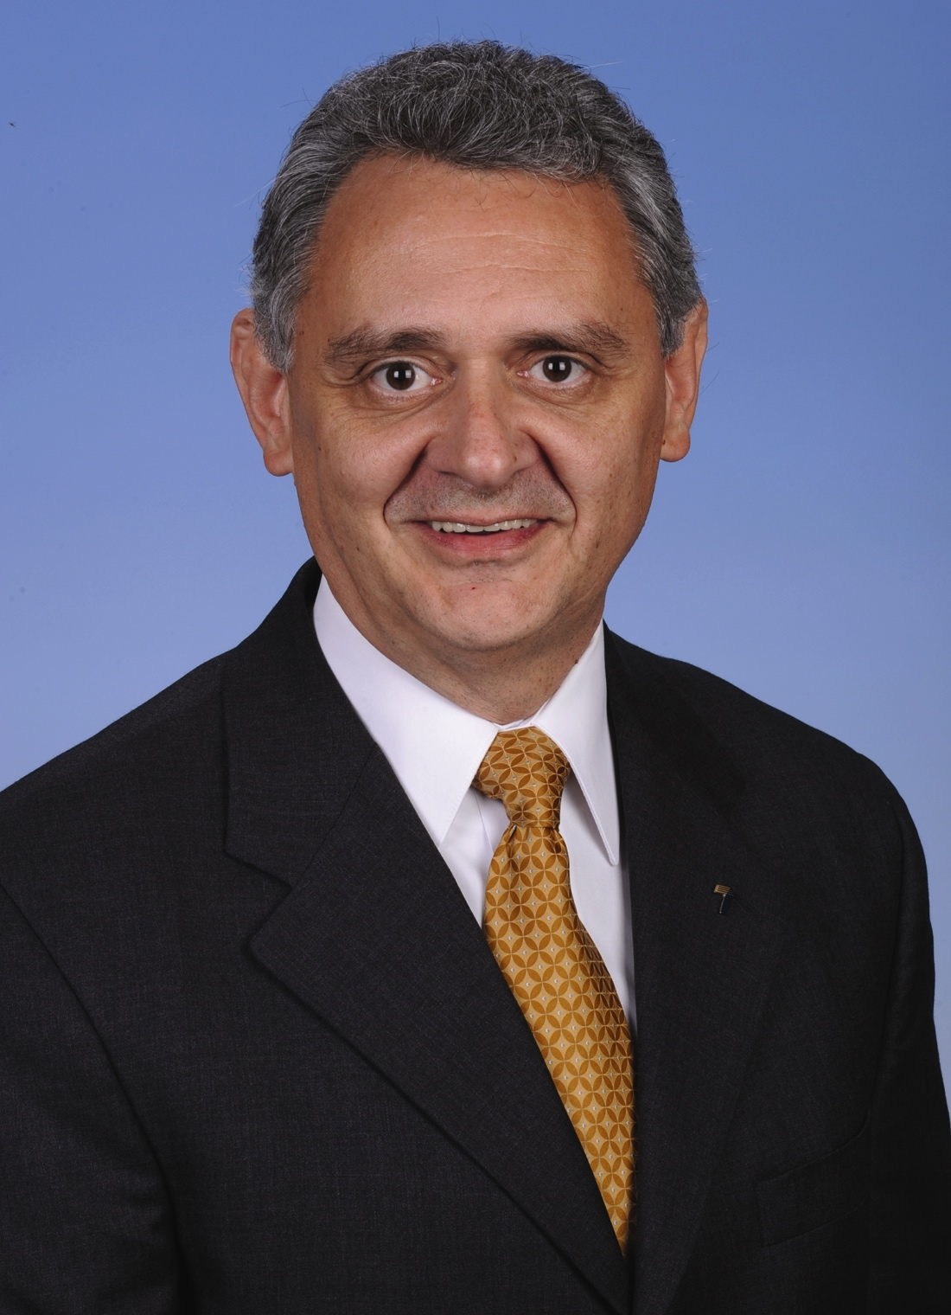

Dr. Terry Pruitt
Deputy Superintendent
Spartanburg School District 7
Welcome From Our Board Chair
Notes:
Terry Pruitt welcomed us.

Slide 5
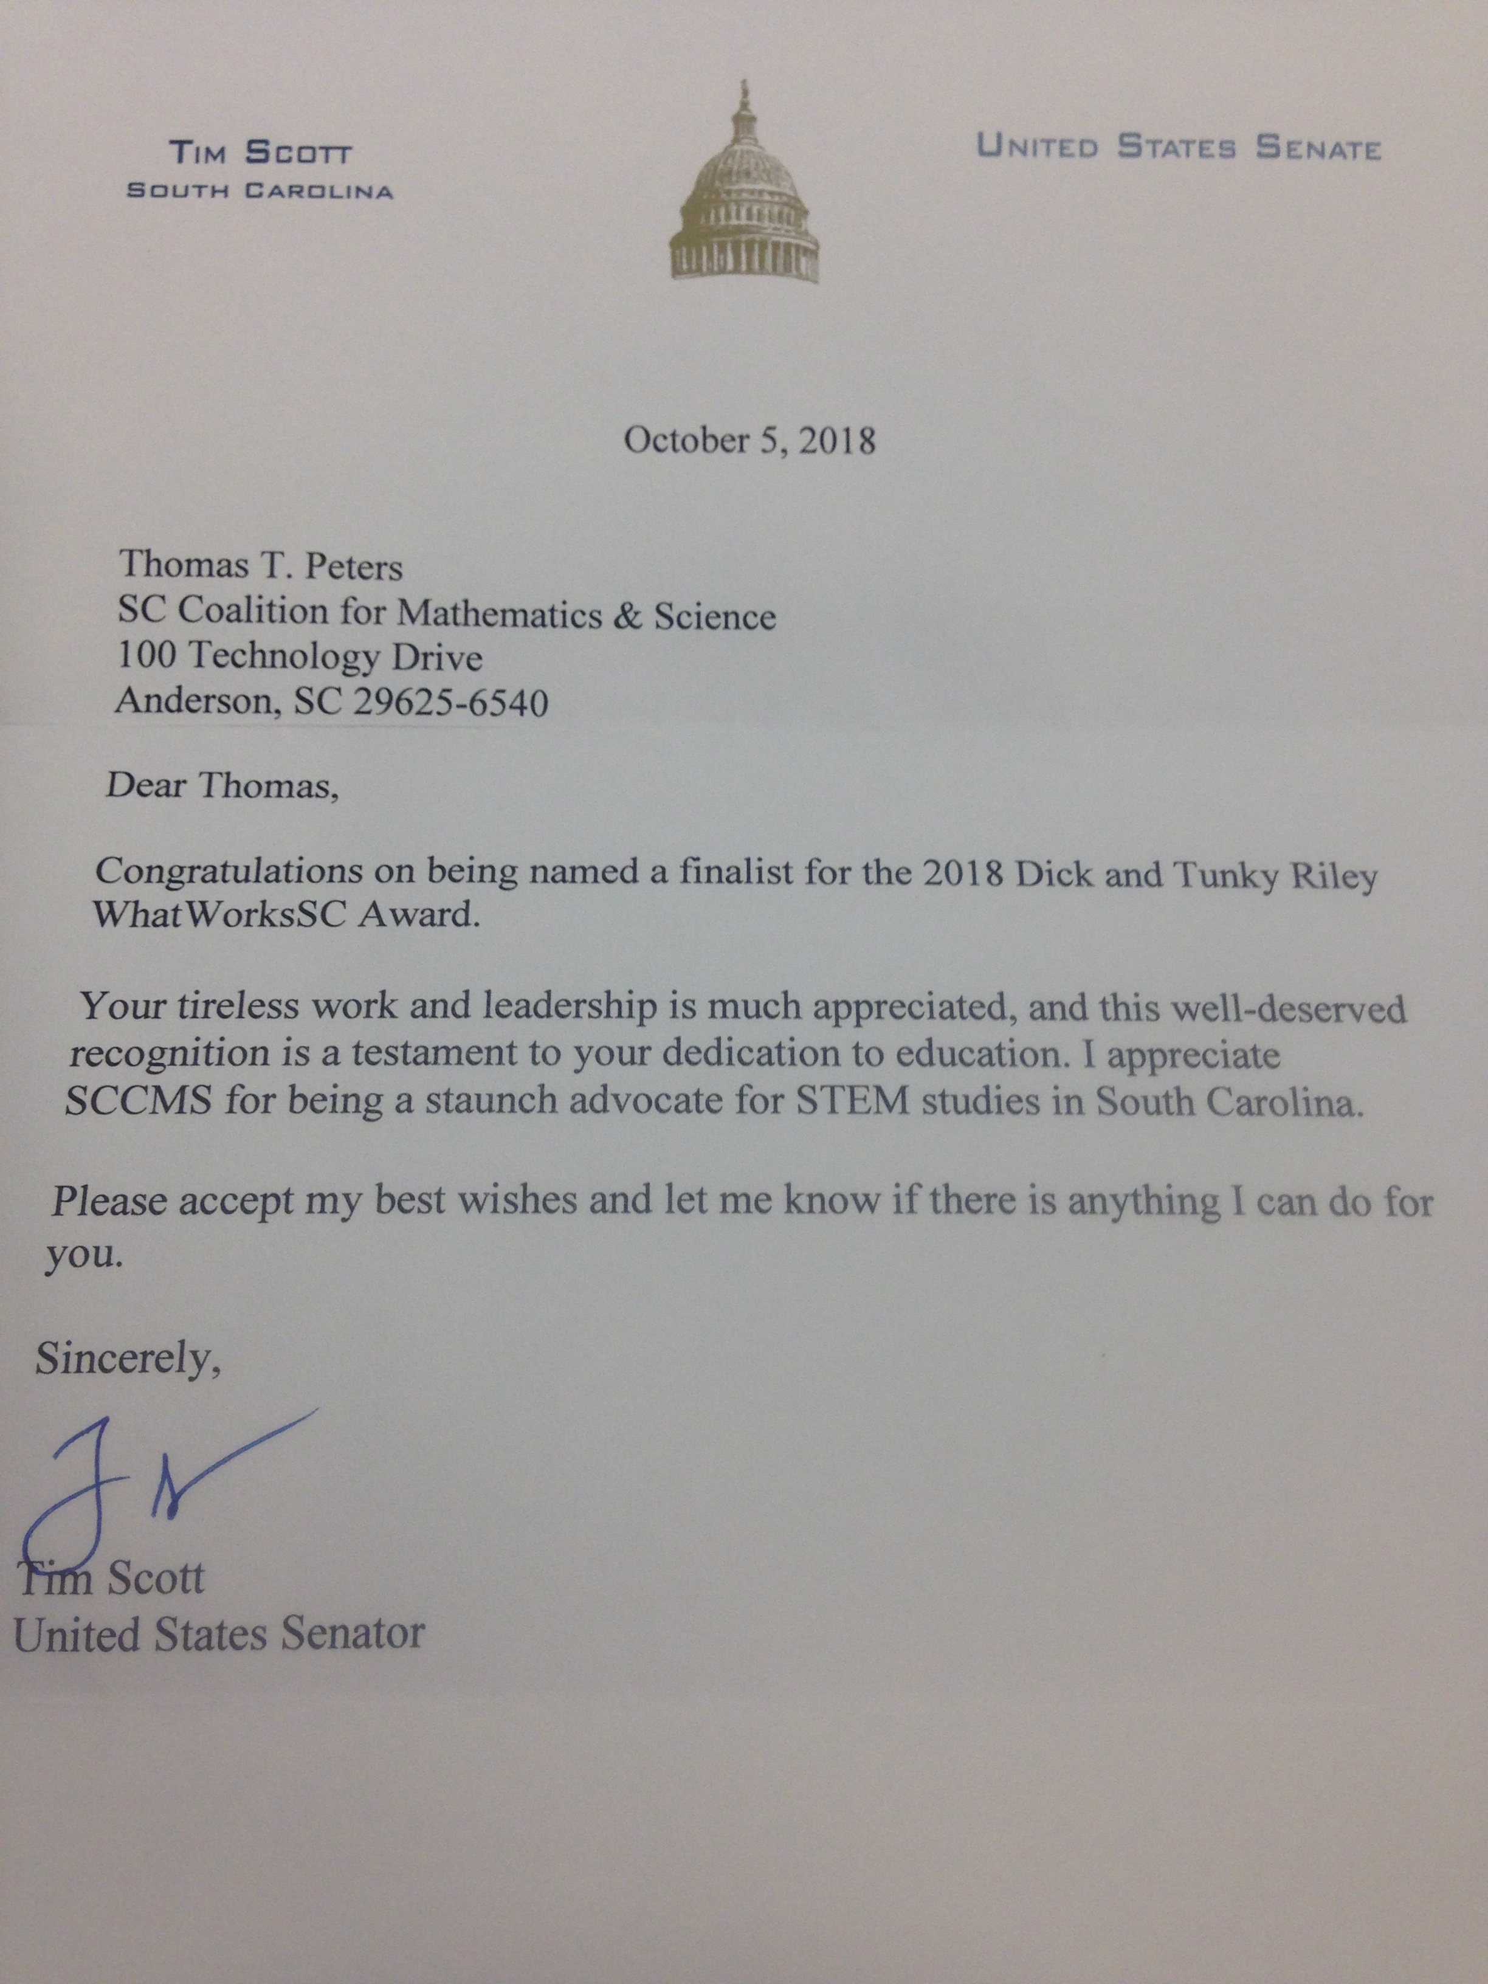

Celebration!!!
2018 Finalist!
Notes:
This recognition was our celebration!

Slide 6


An Aligned STEM Learning Ecosystem
???
United Way of Greenville Co.
Notes:
Our original mission was schools and teacher. Our efforts now are such that we influence the whole of the ecosystem.
We’ve expanded our reach into the “home”/community through our regional STEM Collaboratives and their community STEM festivals.
We serve the out of school time learning community through our partnership with 4H and its Science on the Move, mobile STEM outreach program.
We engage schools in a new way with our “This Schools got STEM” talent competition. Also open to after school programs and judged by STEM professionals.
We engage all sorts of STEM interested humans…and occasionally robots...with state and national STEM conferences and our online STEM asset “map” STEM Linx.
You can learn about any or all of these at: http://www.sccoalition.org/our-organizations-initiatives.html

Slide 7
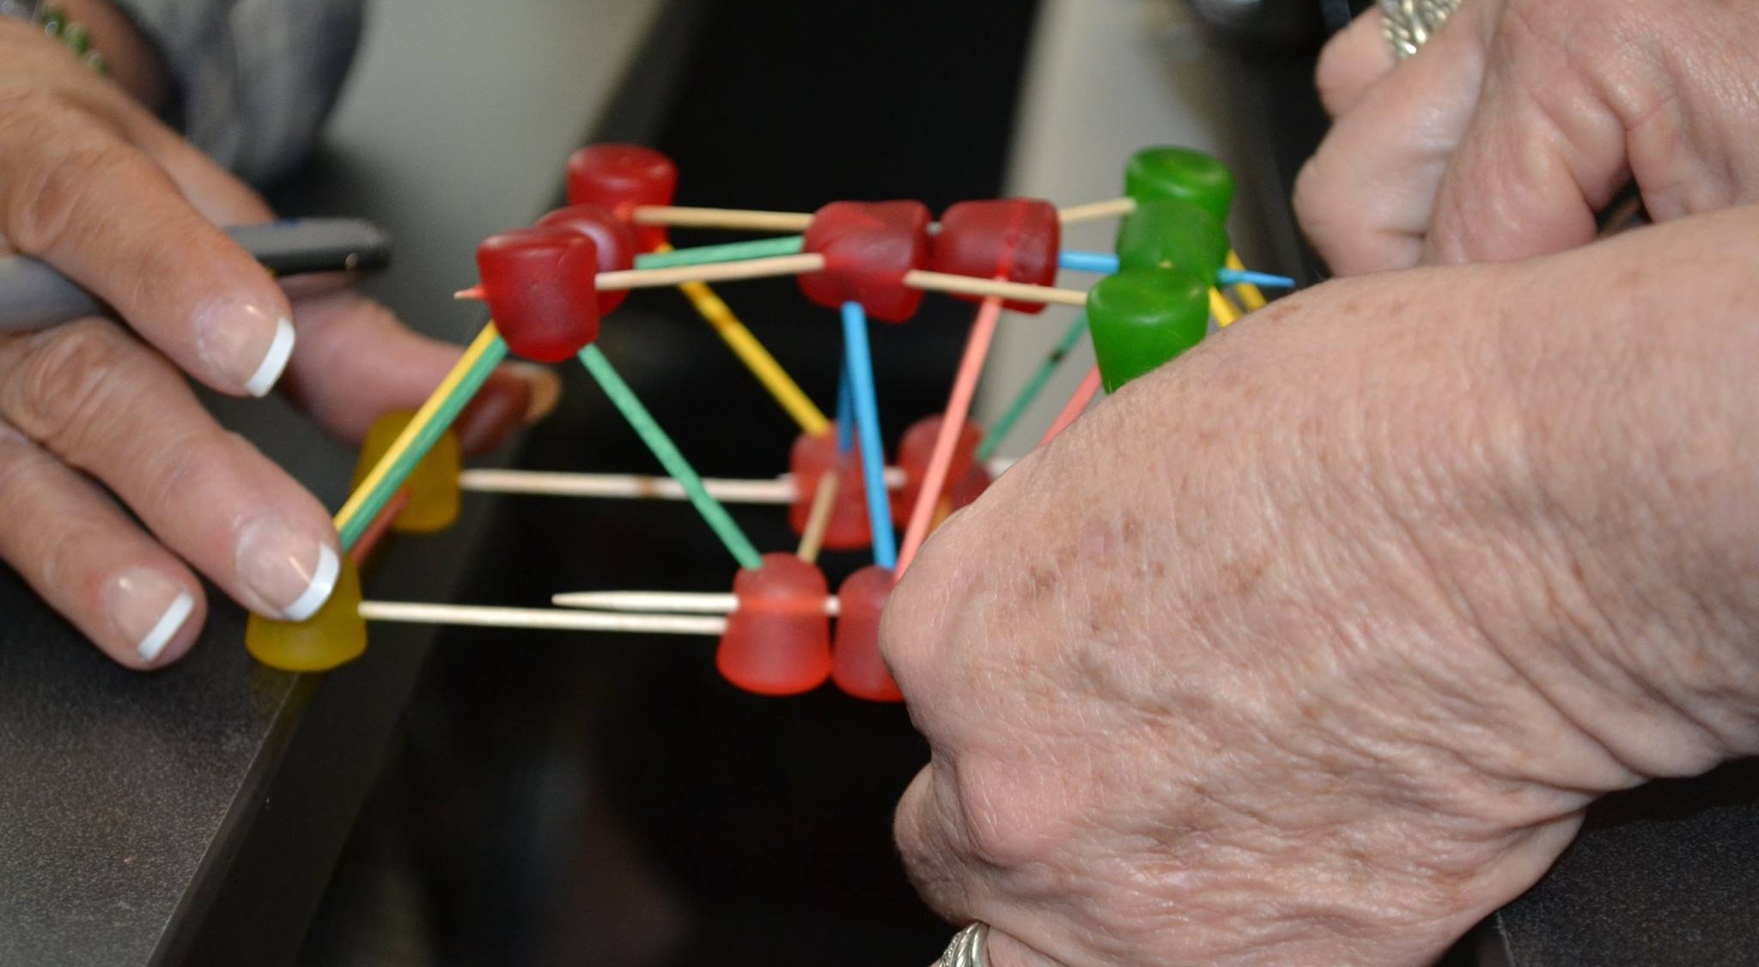
Community Engagement

Slide 8


CHARLESTON: MARCH 9TH
GREENWOOD: MARCH 16TH
GREENVILLE: APRIL 6TH
WILLISTON (DIG) APRIL 27TH
ROCK HILL (SDF) Sept. 28TH
and BEYOND!
Notes:
The iMAGINE brand has expanded to multiple festivals as indicated in the slide.

Slide 9

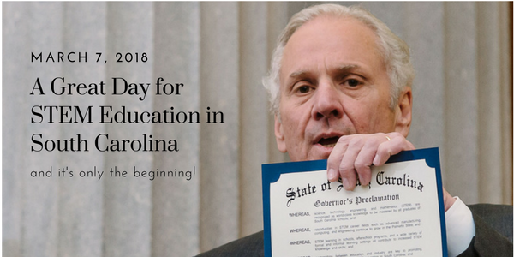
Education Day
@ the Capitol
April 9th
https://www.sccoalition.org/stem-day.html
Notes:
Join us for STEM Education Day at the State Capitol on April 9th.
We¹re looking for schools, business/industry supporting STEM education, and community partners interested in participating in this upcoming event. Fill out the interest form today at https://www.sccoalition.org/stem-day.html

Slide 10


Grand Challenges
October 17th
Notes:
We are continuing efforts to raise the perception and value of STEM teaching as this was the main focus area identified in our Grand Challenges Summit in October of 2017.

Slide 11
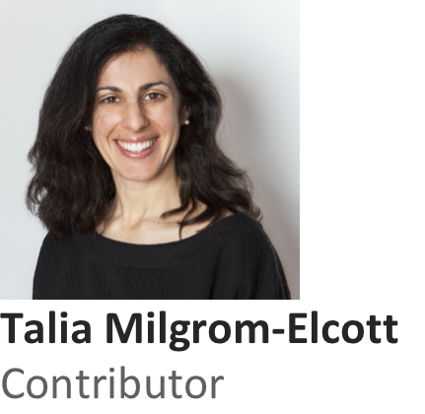
https://www.forbes.com/sites/taliamilgromelcott/2019/01/08/these-5-trends-will-dominate-stem-education-in-2019/#153c039adfca
Jan 8, 2019, 04:25pm
These 5 Trends Will Dominate STEM + Education In 2019
Perceptions Of Teaching Will Improve
Teacher Shortages Will Continue To Strain The System, But Solutions Are Possible
More Schools Will Become Places Where Students and Teachers Thrive
STEM Is Engineering The Future Workforce, Whether You Like It Or Not
STEM Will Lead Schools To A Whole-Child Approach
Grand Challenges
Notes:
Talia Milgrom-Elcott was a keynote speaker at our Grand Challenges Summit. This is a summary of a recent article she wrote. Those present engaged in discussion about relationships between these five trends. Connections to current SC education reform efforts were also made.
There was much discussion around the idea of a “whole child approach”.

Slide 12
Defining STEM & SC STEM Report Card Profile
“Everybody who thinks they know what it means, knows what it means within their field, and everybody else is defining it to fit their own needs.”
Jonathan Gerlach, Albert Einstein Distinguished Educator
http://www.nsta.org/publications/news/story.aspx?id=59305
Notes:
We are working with the SC Department of Commerce to create a definition of STEM Education and STEM Teaching and to develop a set of indicators to track STEM progress in our state. Note that the placeholder name “report card” did not receive a warm welcome. Profile seems to work.
No release date has been determined as of yet.

Slide 13
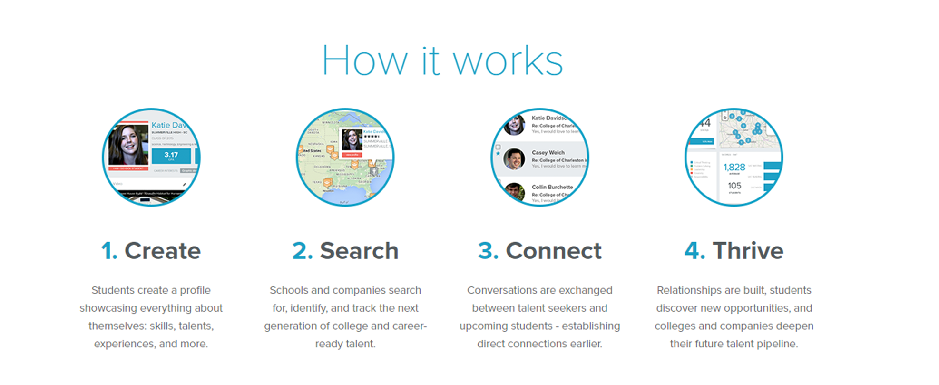
How a STEM Educator Profile Works
Teachers create a profile showcasing themselves: experience, certifications, skills, talents and more.
Schools and districts search for, identify and track qualified, talented STEM educators.
Networking among potential employers and STEM teachers – establishing direct connections.
Relationships are built, teachers discover new opportunities, and schools and districts strengthen their STEM pipeline.
Notes:
We continue the process of formalizing a partnership with STEM Premier (now known as Tallo) to create an educator version of the platform. Given the name change also represents a change in focus from STEM to a broader range of talents, who knows?

Slide 14
Notes:
We’ve received around 150 nominations for our first ever award. The winners will be announced at STEM Education day at the State Capitol on April 9th.

Slide 15
STEm learning ecosystems
The STEM Ecosystems Initiative is built on over a decade of research into successful STEM collaborations, and seeks to nurture and scale effective STEM learning opportunities for all young people.
Launched in Denver at the Clinton Global Initiative, the STEM Funders Network STEM Learning Ecosystems Initiative forms a National Community of Practice with expert coaching and support from leaders such as superintendents, scientists, industry and others.
Notes:
SCCMS is applying as a state for STEM Ecosystem recognition. The application is due on February 28th. Ideally, we will know whether we have been accepted before STEM Education Day. Wish us luck and send in letters if we asked you to.
STEM Learning Ecosystems provide the architecture for cross-sector learning, offering all young people access to STEM-rich learning environments so they can develop important skills and engagement in science, technology, engineering and math throughout preK-16.
Strong STEM Learning Ecosystems feature dynamic collaborations among schools, out-of-school time programs, STEM expert institutions (such as museums, science centers, institutions of higher education and STEM professional associations), the private sector, community-based organizations, youth and families.

Slide 16
Read, reflect, Respond
Making Connections with the STEM Learning Ecosystems Initiative
Building a national community of practice
Amanda Baker
December 26, 2018
All 50 states plant a flag for universal STEM education
Paula Golden
December 21, 2018
Notes:
Meeting participants read these articles about STEM ecosystems and then responded to the questions on the next slide.

Slide 17
THREE points that you agree with
TWO ideas that don’t square with your thinking
ONE question still going around in your mind.
Notes:
Questions from the participants:
General STEM
Why are only 20% prepared in STEM? What is the measure and is it valid?
Who is it that excels in STEM?
What happens to STEM if the Federal Government gets too involved (ie Common Core)?
Ecosystems Initiative
What is the funding model?
What is the vehicle for sharing?
What are our obligations?
What does a culture of collaboration look like?
How does peer to peer sharing work?

Slide 18
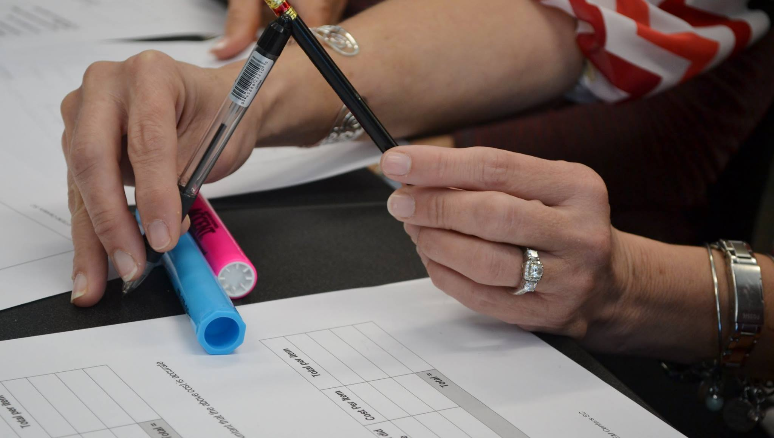
SCCMS Miscellaneous

Slide 19

Discipline 1
Focus on the Wildly Important Goals
1 Expand annual statewide engagement (virtual and face to face) 20% by June 30, 2020.
2. Grow our annual maintenance revenue 20% by June 30, 2020 (Baseline TBD)
3. Increase our overall annual revenue 20% (to approx. $3.25 million) by June 30, 2020.
Notes:
These are the WIGs developed by our Executive Committee to guide our efforts over the next 2 years. Note that these WIGs recognize the essential dilemma of a service organization that relies primarily on external sources for funding. We must serve to be worthy of funding, and be funded in order to serve.

Slide 20


Continuing in 2019+
NSF INCLUDES DDLP Statewide Consortium: Supporting Underrepresented Populations in Precalculus by Organizational Redesign toward Engineering Diversity
CS For All: RPP: A Scalable RPP for Preparing and Supporting Teachers to Teach Culturally Responsive and Rigorous CS Courses in SC High Schools
iSTEM CS: An Innovation Pilot for Preparing and Supporting Middle Grades Teachers to Integrate CS standards into Science, Mathematics & Other Courses
Notes:
SCCMS/S²TEM Center SC provide assistance in two NFS funded STEM Education grants at Clemson University.
Boeing has funded a SCCMS/S²TEM Center SC pilot program for computational literacy instruction in middle grades classrooms.

Slide 21
New collaborations
https://www.advanc-ed.org
https://makeymakey.com
Notes:
These are two of our newest collaborations:
SCCMS/S2TEM centers SC is the official SC training organization for Makey Makey.
AdvancED Collaboration:

Slide 22
New Research
Research Hypothesis: When implemented as part of a systemic STEM education effort consistent with the STEM Theory of Action, the ShareSpace Foundation’s Mars Map Curriculum promotes teacher use of effective instructional strategies and positive student learning outcomes aligned with SC Academic Standards for Science and other subject areas.
Research Grant $60,000
Notes:
This is a new research project beginning in February of 2019.

Slide 23
Ways to Engage
Follow us on social media
https://www.facebook.com/SCCMS.ForEducation
https://twitter.com/SCCMS_STEM
Check out the improved SCCMS website
www.sccoalition.org
Notes:
SCCMS is revamping its social media presence…and yes...I must learn to tweet.

Slide 24
Ways to Engage
Education Reform Bills: South Carolina Career Opportunity and Access for All Act (H. 3759) The Senate companion bill is (S. 419)
Section 6 is all about Computer Science.
Sections 7 and 9 continue science as one of 3 core academic areas, but leaves assessment at grades 4,6 and 8.
Section 22 describes K-12 reading and math performance tracking.
Section 23 eliminates remedial math at IHE’s which could create some serious PD needs for MS and HS teachers.
Sections 26-28 create a whole new way to think about career clusters by abolishing the current 16 clusters.
Section 31 gives tax credits to those who employ grades 6-12 teachers as interns.
Section 34 allows schools with good ratings to hire up to 25% of staff as non-certified teachers.
Section 44 describes what low performing schools will need to do…including the creation of PD plans.
Notes:
Participants shared our thoughts on STEM related aspects of the current Education reform legislation. Dialog was robust and extended beyond the secitions I identified on this slide.

Slide 25
House Education & Public Works Committee
Allison, Merita A. "Rita", Chairman
Young, Ronald "Ronnie", 1st V.C.
Brown, Robert L., 2nd V.C.
Alexander, Terry
Bennett, Linda "Lin"
Brawley, Wendy C.
Calhoon, Paula Rawl
Chellis, Converse A "Con", IV
Cox, Bobby J.
Felder, R. Raye
Govan, Jerry N., Jr.
Long, Steven Wayne
McGinnis, Timothy A "Tim"
Stringer, Tommy M.
Taylor, Bill
Thigpen, Ivory Torrey
Wooten, Chris
Yow, Richard L. "Richie”
Notes:
These are people who need to know your thoughts about education reform.

Slide 26
Senate Education Committee
Hembree, Greg, Chairman
Setzler, Nikki G.
Matthews, John W., Jr.
Rankin, Luke A.
Peeler, Harvey S., Jr.
Jackson, Darrell
Grooms, Lawrence K.
Malloy, Gerald
Hutto, Brad
Sheheen, Vincent A.
Nicholson, Floyd
Young, Tom, Jr.
Turner, Ross
Rice, Rex F.
Talley, Scott
Massey, A. Shane
Cash, Richard J.
Notes:
These are people who need to know your thoughts about education reform.

Slide 27
Ways to Engage - Advocacy
S²TEM Centers SC ($250,000)
The recommendation is to fund the initial design and implementation of a STEM Teacher Fellows program targeted at recruiting and retaining STEM teachers with four to seven years of teaching experience. In the first year, the goal would be to identify non-profit and business support for the program as well. The Subcommittee recommends that, before implementation of the program, that S²TEM Centers SC identify matching funds that would support the program and a detailed project design of the program.
STEM Teacher Fellows Program coordinated by S²TEM Center to recruit and retain STEM teachers
$250,000 $562,500 $312,500
Notes:
This is an initiative we are still trying to launch. We have tentative approval from EOC…IF...there are sufficient EIA funds available.

Slide 28
SCCMS ADVISORY BOARD OPENINGS
SC SCIENCE COMMUNITY
SC MATHEMATICS COMMUNITY
INSTITUTIONS OF HIGHER ED?
Welcome Dr. Regina (Wragg) Ciphrah
- DIVERSITY IN STEM
Notes:
We have a few SCCMS Advisory Board openings to fill. Interested???

Slide 29
Notes:
South Carolina, unlike many other states, has no official STEM plan. We do have a vision for what graduates of SC schools should know, be able to do and value. This profile has been widely accepted by K-12 schools and business industry. Out of school time learning centers and STEM institutions like colleges and universities are likely to be less aware and active in pursing action toward this end.
Learn more about the SC Council on Competitiveness and transform SC at:
http://sccompetes.org/transformsc/

Slide 30
What Questions do you have?
Dr. Tom Peters
Executive Director
tpeters@clemson.edu
864-656-1863
FOUNDING PARTNERS

