Slide 1




Board Meeting
September 18, 2018
Welcome Board & Friends!
Our Founding Partners
Notes:
In Attendance:
Alice Gilchrist
Tom Peters
Cheryl Wiggins*
GP McLeer
Jon Pedersen
Michael Nelson
Terry Pruitt*
Elisabeth Kovacs
Eileen Kraemer
Bill Pederson
John Driscoll
Angie Omer
Shawn Wilson
Regina Wragg
Rebecca Hartley
Pam Temple
Cynthia Curtis
*denoted board member

Slide 2
Our Agenda
11:00 am Meet & Greet
11:30 Lunch – Milliken Cafeteria
12:30 pm Welcome - Milliken
12:40 SCCMS Highlights
1:10 Eliza Gallager CU NSF grant
1:25 Eileen Kramer CU NSF Grant
1:40 Susie Teague SDF Partnership
1:55 Wild about WIGs
2:30 Advocacy
3:00 ish Optional Tour
Notes:
This was our agenda. We sort of stuck to it and finished just in time.

Slide 3
SC INCLUDES, a statewide organization whose central mission is to bring together the K-12 system, technical colleges and higher education to work toward diversifying the engineering workforce so that it is representative of the population as a whole.
Welcome From Our Host
Notes:
Stacy Walker, Corporate Director of Brand Experience, welcomed us and gave us an overview of Milliken.
Special thanks to Heidi W. Burmeister, Senior Account Manager, Commercial and Hospitality Markets, Milliken Design, Inc., for managing our on-site logistics.

Slide 4
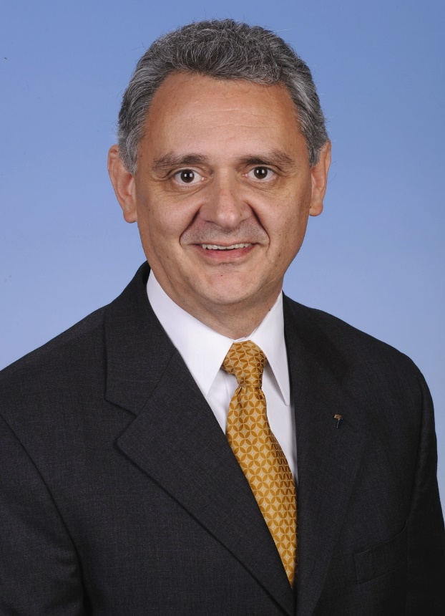

Dr. Terry Pruitt
Deputy Superintendent
Spartanburg School District 7
Welcome From Our Board Chair
Notes:
Terry Pruitt welcomed us. Thanks Terry for arranging the meeting to be at Milliken.

Slide 5
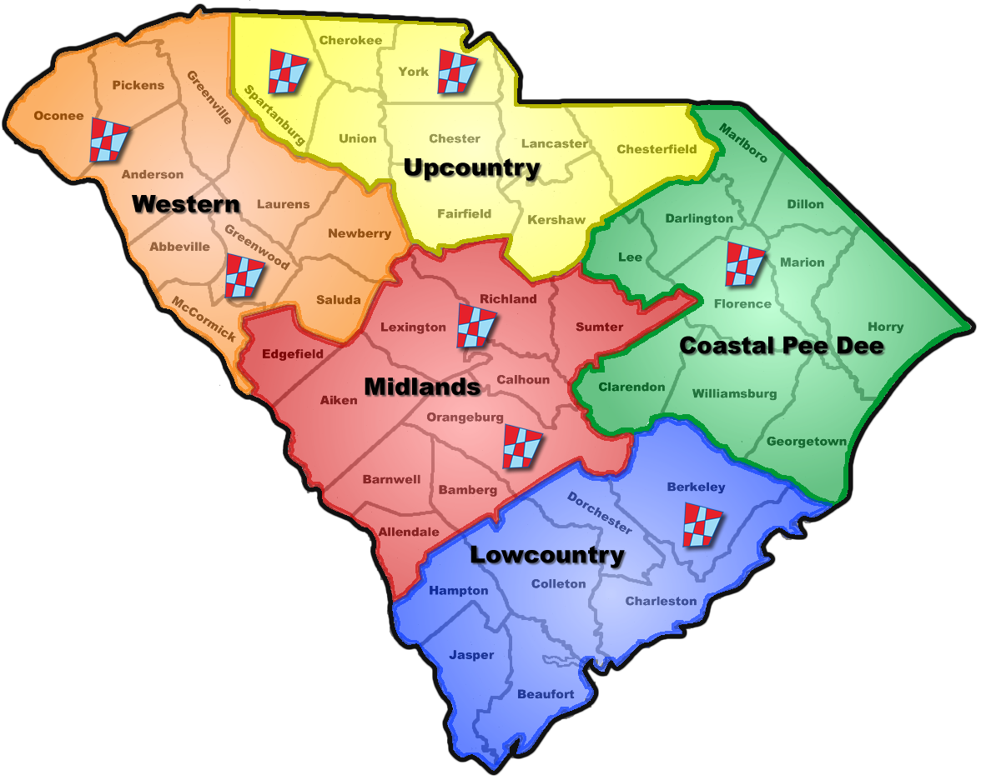



South Carolina’s Statewide STEM Infrastructure - A Brief History
S²TEM Centers SC
Five regional S²TEM Centers design and deliver alignment, information, support, innovation, and research actions across the SC STEM Ecosystem.
Present
S²MART Centers SC
Eight regional S²MART Centers supported instructional coaching, projects serving Title 1 and Technical Assistance schools, and more.
2009 - 2011
The Mathematics & Science Unit (MSU)
Eight regional Mathematics & Science Centers supported instructional coaching, standards implementation, and more.
Mathematics & Science
Regional Centers
2003 - 2009
The SC Statewide Systemic Initiative (SC SSI)
Thirteen regional Hubs provided teacher and administrator leadership development, science/math kits, and more.
The Hubs
1993 - 2003
Notes:
Our statewide infrastructure for support of STEM content areas was formed in 1993 in response to specific and persistent trends in both student performance and access to resources. South Carolina remains a state in which economic growth, income, education opportunities and other resources that promote interest and success and spawn innovation in mathematics and science are unequally distributed.
Known over the years as "Hubs" (1993 - 2002), "Mathematics & Science Regional Centers" (2003 - 2009), "S²MART Centers" (2009 - 2011) and now S²TEM Centers SC, our statewide infrastructure for STEM education brings information, support, innovation and research to the education community with emphasis on K-12 schools.
Some examples of how our statewide infrastructure has advanced the vision and values of STEM education include:
Widespread use of exemplary curriculum materials developed through our LASER initiative (1998 – 2003).
Increased school level capacity for instructional improvement and information sharing led by instructional coaches (2003 to present).
Networking of Title 1 schools through LeadS²MART (2009 to present).
Profile of the SC Graduate in all its many STEM iterations (2010 to present).

Slide 6
Notes:
South Carolina, unlike many other states, has no official STEM plan. We do have a vision for what graduates of SC schools should know, be able to do and value. This profile has been widely accepted by K-12 schools and business industry. Out of school time learning centers and STEM institutions like colleges and universities are likely to be less aware and active in pursing action toward this end.
Learn more about the SC Council on Competitiveness and transform SC at:
http://sccompetes.org/transformsc/

Slide 7


An Aligned STEM Learning Ecosystem
STEM
TOY
SCFM
Comp
???
United Way of Greenville Co.
Notes:
Our original mission was schools and teacher. This is still the core of our work through S²TEM Centers SC. Our efforts now are such that we influence the whole of the ecosystem.
We’ve expanded our reach into the “home”/community through our regional STEM Collaboratives and their community STEM festivals.
We serve the out of school time learning community through our partnership with 4H Science on the Move and Dreams Imagination & Gift.
We are developing a STEM Teacher of the Year award program with SC Future Minds and Comporium. We are hoping to add Million Women Mentors SC to our family of organizations very soon.
We engage all sorts of STEM interested humans…and occasionally robots...with state and national STEM conferences and our online STEM asset “map” STEM Linx.
You can learn about any or all of these at: https://www.sccoalition.org/news--initiatives.html

Slide 8


Continuing in 2018/19!
NSF INCLUDES DDLP Statewide Consortium: Supporting Underrepresented Populations in Precalculus by Organizational Redesign toward Engineering Diversity
CS For All: RPP: A Scalable RPP for Preparing and Supporting Teachers to Teach Culturally Responsive and Rigorous CS Courses in SC High Schools
iSTEM CS: An Innovation Pilot for Preparing and Supporting Middle Grades Teachers to Integrate CS standards into Science, Mathematics & Other Courses
Notes:
SCCMS/S²TEM Center SC provide assistance in two NFS funded STEM Education grants at Clemson University.
Boeing has funded a SCCMS/S²TEM Center SC pilot program for computational literacy instruction in middle grades classrooms. We are engaging teachers in professional learning experiences through the 2018/19 school year.

Slide 9
SC INCLUDES, a statewide organization whose central mission is to bring together the K-12 system, technical colleges and higher education to work toward diversifying the engineering workforce so that it is representative of the population as a whole.
Eliza Gallagher
Assistant Professor, Joint appointment with Engineering & Science Education and Mathematical Sciences
Notes:
Eliza was unable to join us. This effort focuses on researching factors that impact student success in precalculus as a precursor to success in engineering degree programs.

Slide 10
Clemson faculty researchers are using a near $1 million grant from the National Science Foundation to help computer science teachers across SC develop teaching methods that better serve the state’s diverse population. The research aims to broaden participation in computer science by improving teaching methods for different student audiences.
Eileen T. Kraemer, Ph.D.
C. Tycho Howle Director
School of Computing
Clemson University
Notes:
Eileen gave us a brief overview of CRoCS (pronounced crocus, like the flower). See https://computing.clemson.edu/crocs/ for information about this research effort focused on preparing and supporting teachers to teach culturally responsive Computer Science courses in South Carolina high schools

Slide 11
The mission of the STEM Development Foundation (SDF) is to bring together community leaders to foster Science, Technology, Engineering and Math (STEM) education, work to increase the number of participants in STEM programs in K-12, Technical Colleges and Universities, and to be a hub for STEM activities.
Susanne Teague
Executive Director
Notes:
Susie was unavailable, so I gave a brief overview of the details of this partnership and some of the STEM development Foundation’s programs. Learn more at https://www.stemdevelopmentfoundation.org/

Slide 12


Continuing in 2018/19!
October 17th
& STEM Premier for Educators too!
Notes:
In partnership with 100Kin10 and STEMx we sorted through multiple challenges that our state faces in improving STEM education to identify a handful that we can act upon with reasonably immediate results back in October of 2017.
We launched our findings on STEM Day at the State Capitol, March, 14, 2018. Our efforts continue with many partners.

Slide 13
Defining STEM & SC STEM Report Card Profile
New-ish in 2018/19!
“Everybody who thinks they know what it means, knows what it means within their field, and everybody else is defining it to fit their own needs.”
Jonathan Gerlach, Albert Einstein Distinguished Educator
http://www.nsta.org/publications/news/story.aspx?id=59305
Notes:
We are working with the SC department of Commerce to create a definition of STEM Education and STEM Teaching and to develop a set of indicators to track STEM progress in our state. Note that the placeholder name “report card” did not receive a warm welcome. Profile seems to work.

Slide 14

and BEYOND!
Expanding in 2018/19!
Notes:
We are involved in multiple festivals including Rock Hill (October 27), Florence ( November 3), Greenwood (TBD), Sumter (TBD) and, of course our original festivals in Charleston (March 9 ) and Greenville (April 6). This seems to be a growing area of engagement for us and we are adding another staff member.

Slide 15

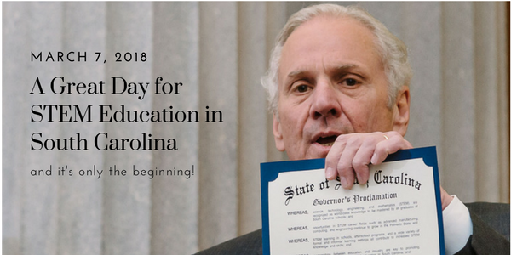
Continuing in 2019!
Education Day @ the Capitol
Notes:
Our second annual STEM Education day at the State Capitol will be held on either Pi Day (March 14, 2019) or in partnership with STEM Signing Day (TBD). More ASAP.

Slide 16

New Recognition?
Finalist????
Notes:
Are we one of three finalists? You will find out soon enough!

Slide 17
New Recognition?
The STEM Ecosystems Initiative is built on over a decade of research into successful STEM collaborations, and seeks to nurture and scale effective STEM learning opportunities for all young people.
Launched in Denver at the Clinton Global Initiative, the STEM Funders Network STEM Learning Ecosystems Initiative forms a National Community of Practice with expert coaching and support from leaders such as superintendents, scientists, industry and others.
Notes:
In the spring, we will apply as a state for STEM Ecosystem recognition.
STEM Learning Ecosystems provide the architecture for cross-sector learning, offering all young people access to STEM-rich learning environments so they can develop important skills and engagement in science, technology, engineering and math throughout preK-16.
Strong STEM Learning Ecosystems feature dynamic collaborations among schools, out-of-school time programs, STEM expert institutions (such as museums, science centers, institutions of higher education and STEM professional associations), the private sector, community-based organizations, youth and families.

Slide 18






State Investment
Continuing in 2018/19!
$1,750,000.00
Program Generated Funds
$1,000,000+
Charleston
STEM Festival
Notes:
In 2017/18, SCCMS through its family of affiliated programs and services was able to generate an additional $1,005,724 in support of STEM education thanks to the General Assembley’s $1.75 million investment.

Slide 19
Wild about WIGs!
Rethinking our Data Profile With…
Notes:
We are working in partnership with Total Comfort Solutions (TCS) to rethink our data profile. They introduced us to Wildly Important Goals (aka WIGs)

Slide 20
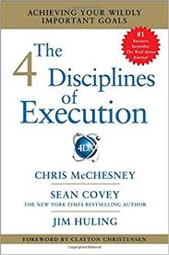
The 4 Disciplines of Execution
DISCIPLINE 1: Focus on the Wildly Important Goals
DISCIPLINE 2: Act on Lead Measures
DISCIPLINE 3: Keep a Compelling Scorecard
DISCIPLINE 4: Create a Cadence of Accountability
Notes:
This is the resource TCS uses to guide their business thinking.

Slide 21
Discipline 1
Focus on the Wildly Important Goals
-There will always be more good ideas than there is capacity to execute –
Execution 4:37
Notes:
This is always one of our challenges. Too many good ideas in STEM.

Slide 22
Discipline 1
Focus on the Wildly Important Goals
4 Minute Read
How to Set Wildly Important Goals and What They’ll Do for You
Chris McChesney
Notes:
We asked participants to read this article first to give them some instant WIG background.
https://www.fastcompany.com/1835210/how-set-wildly-important-goals-and-what-theyll-do-you

Slide 23

Discipline 1
Focus on the Wildly Important Goals
1 Expand annual statewide engagement (virtual and face to face) 20% by June 30, 2020 .
2. Grow our annual maintenance revenue 20% by June 30, 2020 (Baseline TBD)
3. Increase our overall annual revenue 20% (to approx. $3.25 million) by June 30, 2020
These are the Executive Committee set goals for SCCMS
Notes:
These are the WIGs developed by our Executive Committee to guide our efforts over the next 2 years. Note that these WIGs recognize the essential dilemma of a service organization that relies primarily on external sources for funding. We must serve to be worthy of funding, and be funded in order to serve.

Slide 24
Discipline 1
Focus on the Wildly Important Goals
THREE thoughts about our WIGs
TWO actions that might support our WIGs
ONE question still going around in your mind.
Notes:
Participants were asked to reflect on our WIGs. These will be shared with the SCCMS executive committee for discussion and action. Thanks to all who contributed their thinking!

Slide 25
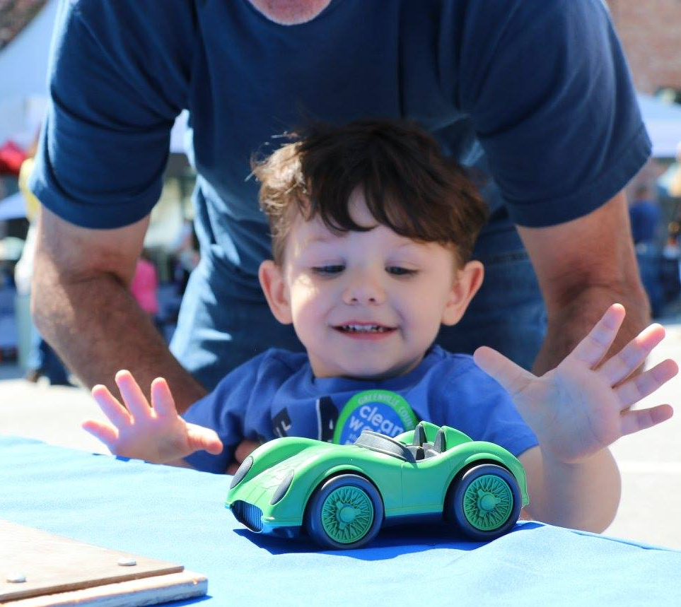
Your Advocacy for…
“Drop dead minimum request” to maintain what we do now is $2,000,000
(increase of $250,000)
“But if you want retention of 75 + STEM teachers”, then we need $3,125,000.
(increase of $250,000 + $1,125,000)
Notes:
This is the funding request we will present to the Education Oversight Committee on October 29th.

Slide 26
House Ways and Means Committee
W. Brian White, Chairman, J. Gary Simrill, 1st V.C.
Gilda Cobb-Hunter, 2nd, V.C, .Michael A. "Mike" Anthony,
Jimmy C. Bales, Ed.D, .Nathan Ballentine, Alan D.
Clemmons, William "Bill" Clyburn, J. Derham Cole, Jr.,
Heather Ammons Crawford, Shannon S. Erickson,
Kirkman Finlay, III, Jackie E. "Coach" Hayes, William G.
"Bill" Herbkersman, Lonnie Hosey, Chip Huggins, Dwight
Loftis, Phillip D. Lowe, Michael A. Pitts, J. Todd
Rutherford, G. Murrell Smith, Jr., Garry R. Smith, F.
Michael "Mike" Sottile, Leonidas E. "Leon" Stavrinakis,
William R. "Bill" Whitmire
Notes:
Want to help? These are people who need to know you appreciate our work.

Slide 27
Senate Finance Committee
Hugh K. Leatherman, Sr., Chairman, Nikki G. Setzler, Harvey S. Peeler, Jr, .John W. Matthews, Jr., Glenn G. Reese, Thomas C. Alexander, Lawrence K. "Larry" Grooms, Daniel B. "Danny" Verdin, III, Ronnie W. Cromer, Darrell Jackson, Kent M. Williams, Paul G. Campbell, Jr., Tom Davis, Floyd Nicholson, Vincent A. Sheheen, Shane R. Martin, John L. Scott, Jr., Karl B. Allen, Chauncey K. Gregory, Sean M. Bennett, Thomas D. "Tom" Corbin, Greg Hembree
Notes:
Want to help? These are people who need to know you appreciate our work.

Slide 28
What Questions do you have?
Dr. Tom Peters
Executive Director
tpeters@clemson.edu
864-656-1863
FOUNDING PARTNERS

