Slide 1




Board Meeting
October 26, 2017
Welcome Board & Friends!
Our Founding Partners
Notes:
In Attendance:
Steven Brown
Stephanie Cugini
Donn Griffith*
Rebecca Hartley
GP McLeer
Bill Pedersen
Tom Peters
Terry Pruitt*
Gwendolyn Shealy
Susie Teague
Cheryl Wiggins*
Regina Wragg
Jodi Zeis
*denoted board member

Slide 2
Our Agenda
11:00 am Meet & Greet
11:15 Welcomes
11:30 Lunch from Cribbs Catering
12:15 pm Program including SCCMS Annual Review and Grand Challenges in SC STEM Update
3:15ish Adjourn
Notes:
This was our agenda. We stuck to it really well and finished a bit ahead of time.

Slide 3

Brandon Gibson,
HR Generalist
Welcome From Our Host
Notes:
Brandon Gibson, HR Generalist
Welcomed us and gave us an overview QS/1 and other companies that are part of the JM Smith Corporation.

Slide 4
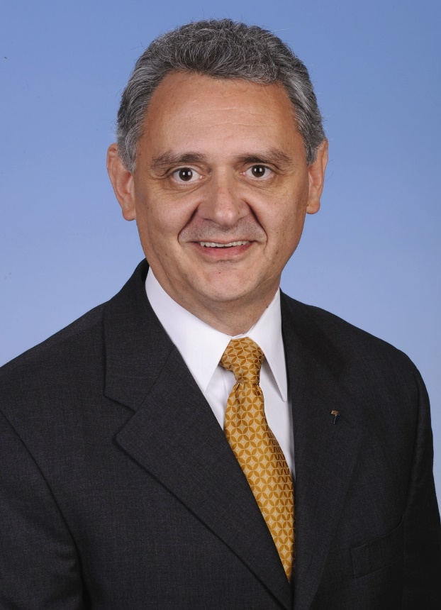

Dr. Terry Pruitt
Deputy Superintendent
Spartanburg School District 7
Welcome From Our Board Chair

Slide 5
An Aligned STEM Learning Ecosystem
Notes:
Our original mission was schools and teacher. Our efforts now are such that we influence the whole of the ecosystem.
We’ve expanded our reach into the “home”/community through our regional STEM Collaboratives and their community STEM festivals.
We serve the out of school time learning community through our partnership with 4H and its Science on the Move, mobile STEM outreach program.
We engage schools in a new way with our “This Schools got STEM” talent competition. Also open to after school programs and judged by STEM professionals.
We engage all sorts of STEM interested humans…and occasionally robots...with state and national STEM conferences and our online STEM asset “map” STEM Linx.
You can learn about any or all of these at: http://www.sccoalition.org/our-organizations-initiatives.html

Slide 6

L
U
N
C
H
T
I
M
E
Notes:
We had a delicious lunch from Cribb’s Catering.

Slide 7







October 17th
Notes:
Susie Teague guided the group through a series of activities to inform those who missed the Grand Challenges Summit on October 17.

Slide 8
Convening Objectives
Gather recommendations to inform South Carolina’s STEM priorities
Network with current and potential allies
Refine and finalize grand challenges for South Carolina
Identify players already working on the challenges
Generate solutions for making further progress on the challenges
Notes:
This is an overview of the Grand Challenges Summit objectives.

Slide 9
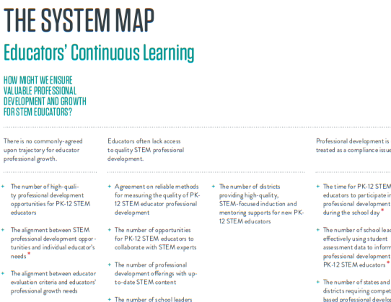
Super Theme
Theme
Cluster
Challenge
Indicates Catalyst Challenge
Notes:
This is a sample 100Kin10 Grand Challenges map.

Slide 10
SC Super Themes
Value + Perception
Educators’ Continuous Learning
Elementary Education
Instructional Resources
Notes:
These are super themes identified through interviews of dozens of SC STEM stakeholders.

Slide 11
Additional catalysts identified as a result of SC data from interviews
The number of school leaders who are trained in fostering collaborative work environments (Value & Perception: Prestige)
PK-12 STEM educator involvement in the selection of professional development (Value & Perception: Leadership)
The number of school leaders who understand the professional development needs of PK-12 STEM educators (Educators’ Continuous Learning: Professional Development)
The number of professional development opportunities for PK-12 educators that focus on how to engage students in active STEM learning experiences (Educators’ Continuous Learning: Professional Development)
Notes:
These are catalysts for change identified through interviews of dozens of SC STEM stakeholders.

Slide 12
The System Map
Read through each column of the map overview
Determine the Super Theme and specific area in which you have expertise/knowledge to assist with moving forward (perhaps a 1st, 2nd, and 3rd choice…)
Find your group partner(s)
Be prepared to be flexible – team effort vs. individual effort
Notes:
Susie Teague guided the group through a series of activities to dive deeper into the 100Kin10 Grand Challenges data set.

Slide 13



Color Question Brainstorming
Imagination, Possibility – “What might happen if we…”
Facts, Figures, Data – “How many….” or “How much…”
Opinions, Values, Needs – “Why is this….” or What’s the best way to…”
Notes:
Susie Teague guided the group through a series of activities to dive deeper into the 100Kin10 Grand Challenges data set.

Slide 14
Brainstorm Share out (1 each)
Imagination, Possibility – “What might happen if we…”
Facts, Figures, Data – “How many….” or “How much…”
Opinions, Values, Needs – “Why is this….” or What’s the best way to…”
Notes:
Susie Teague guided the group through a series of activities to dive deeper into the 100Kin10 Grand Challenges data set.

Slide 15
Overall Reflections from Summit Data
Trends in dialogue?
  Shared vision, goals & collective understanding among all stakeholders
  Funding
  Shared accountability system
Recommendations for next steps?
  Continued collaboration among all stakeholders
  Develop & implement a reasonable timeline/strategic plan statewide
  Focus on PK-16, interdisciplinary, all teachers
Notes:
These are reflections from Grand Challenges Summit participants.

Slide 16
Overall Reflections from Summit Data
Excitements?
  Beginning of educational change that is needed; time is now
  Variety of stakeholders that have collaborated and are at the table
  Potential partnerships and collaborations in future
Potential roadblocks?
  Mandates hinder education transformation
  Inconsistent/lack of funding
  Time, Commitment
Notes:
And more…

Slide 17

Vote!
Which challenge(s) should South Carolina prioritize?
Notes:
Susie Teague asked the group to prioritize next steps. Priorities will be revealed after further data gathering.

Slide 18

What is your commitment?
Notes:
Susie Teague asked the group to make individual commitments for next steps that they will take to support action around Grand Challenges in SC STEM Education..

Slide 19

What’s next?
Notes:
Susie and Tom identified a few next steps we’ll take to gather more data, sort priorities and launch the final challenges for SC.

Slide 20
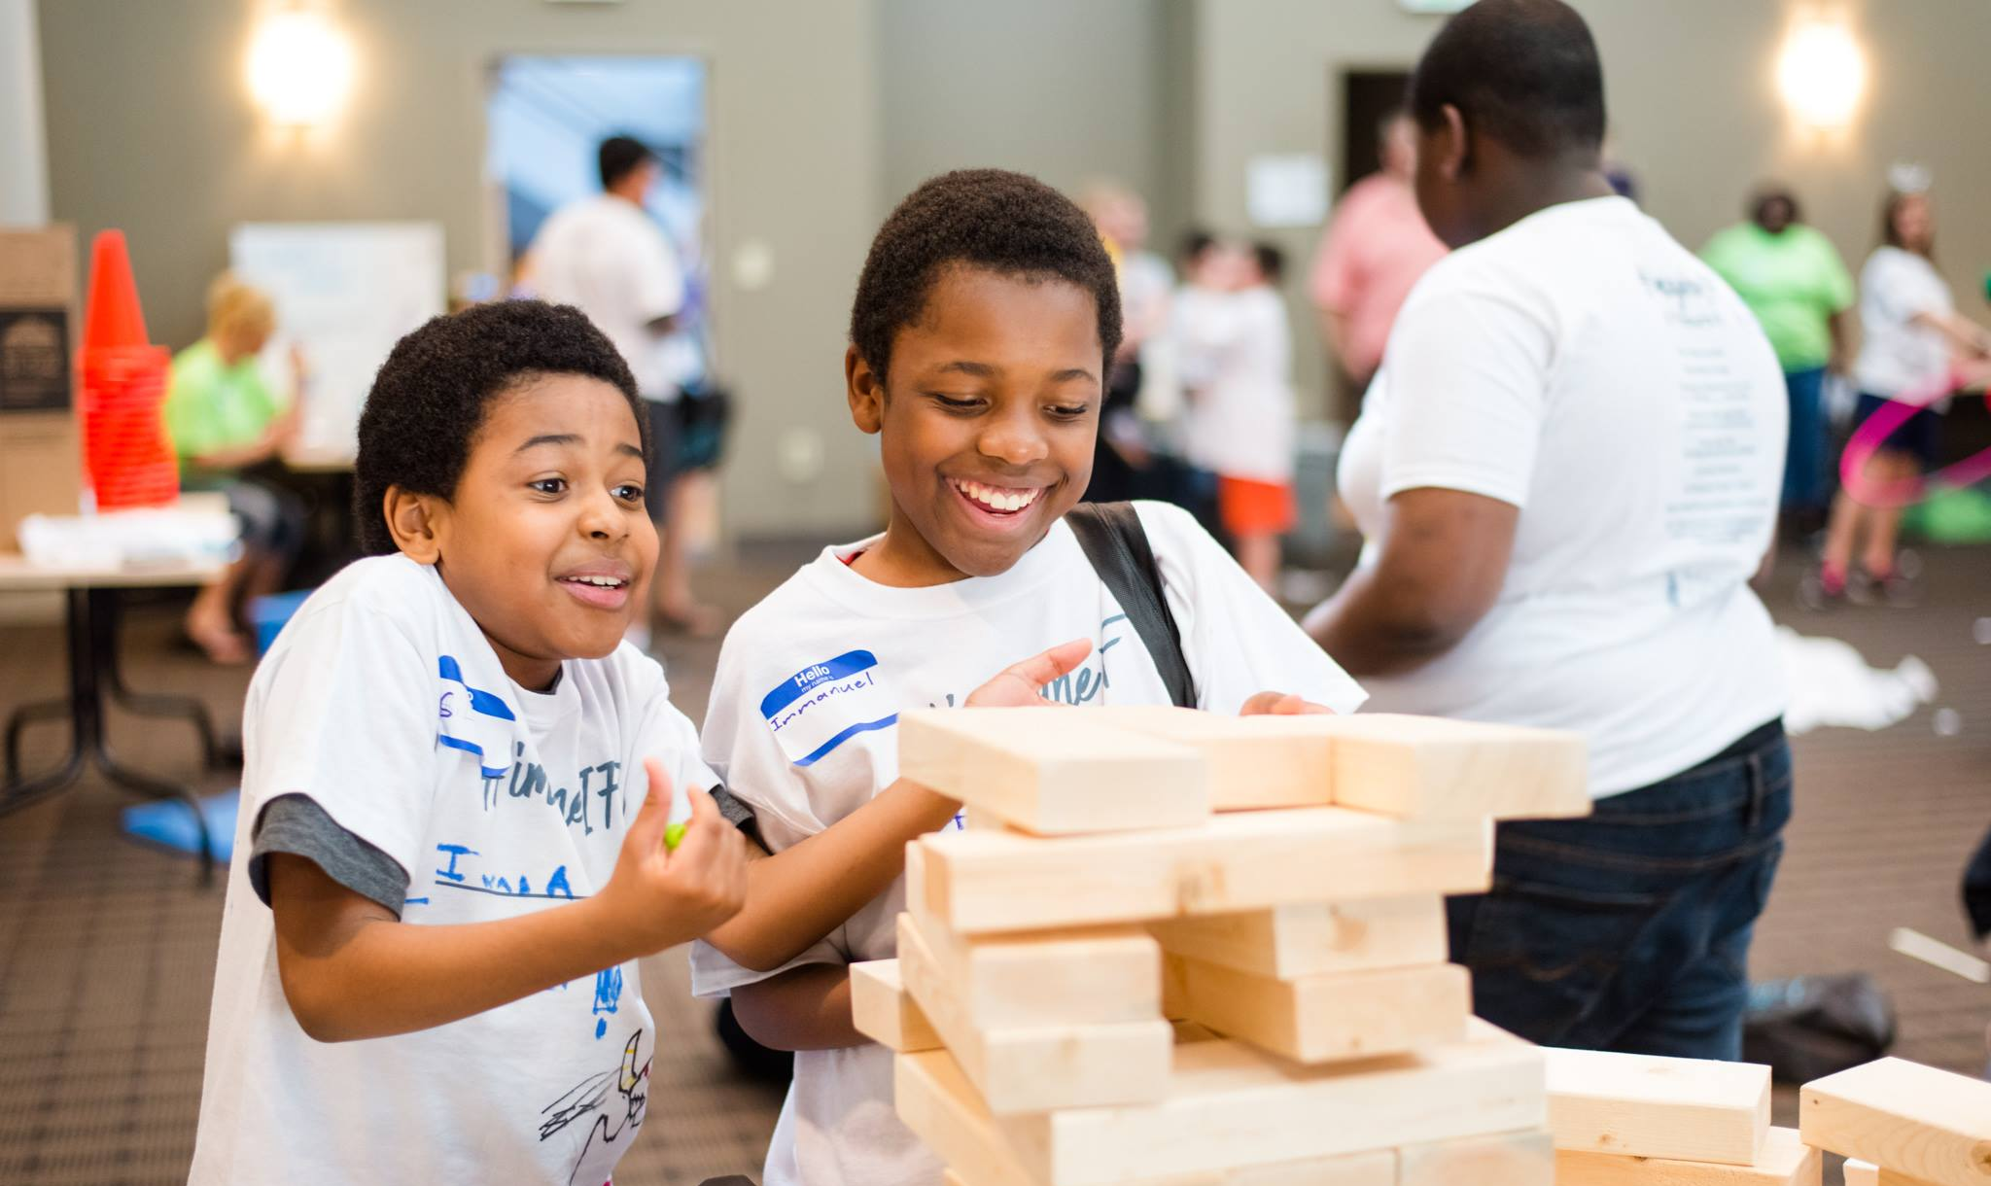
2016-17 Year in Review
Notes:
Tom gave a review of the performance of SCCMS programs for the pervious fiscal year.

Slide 21





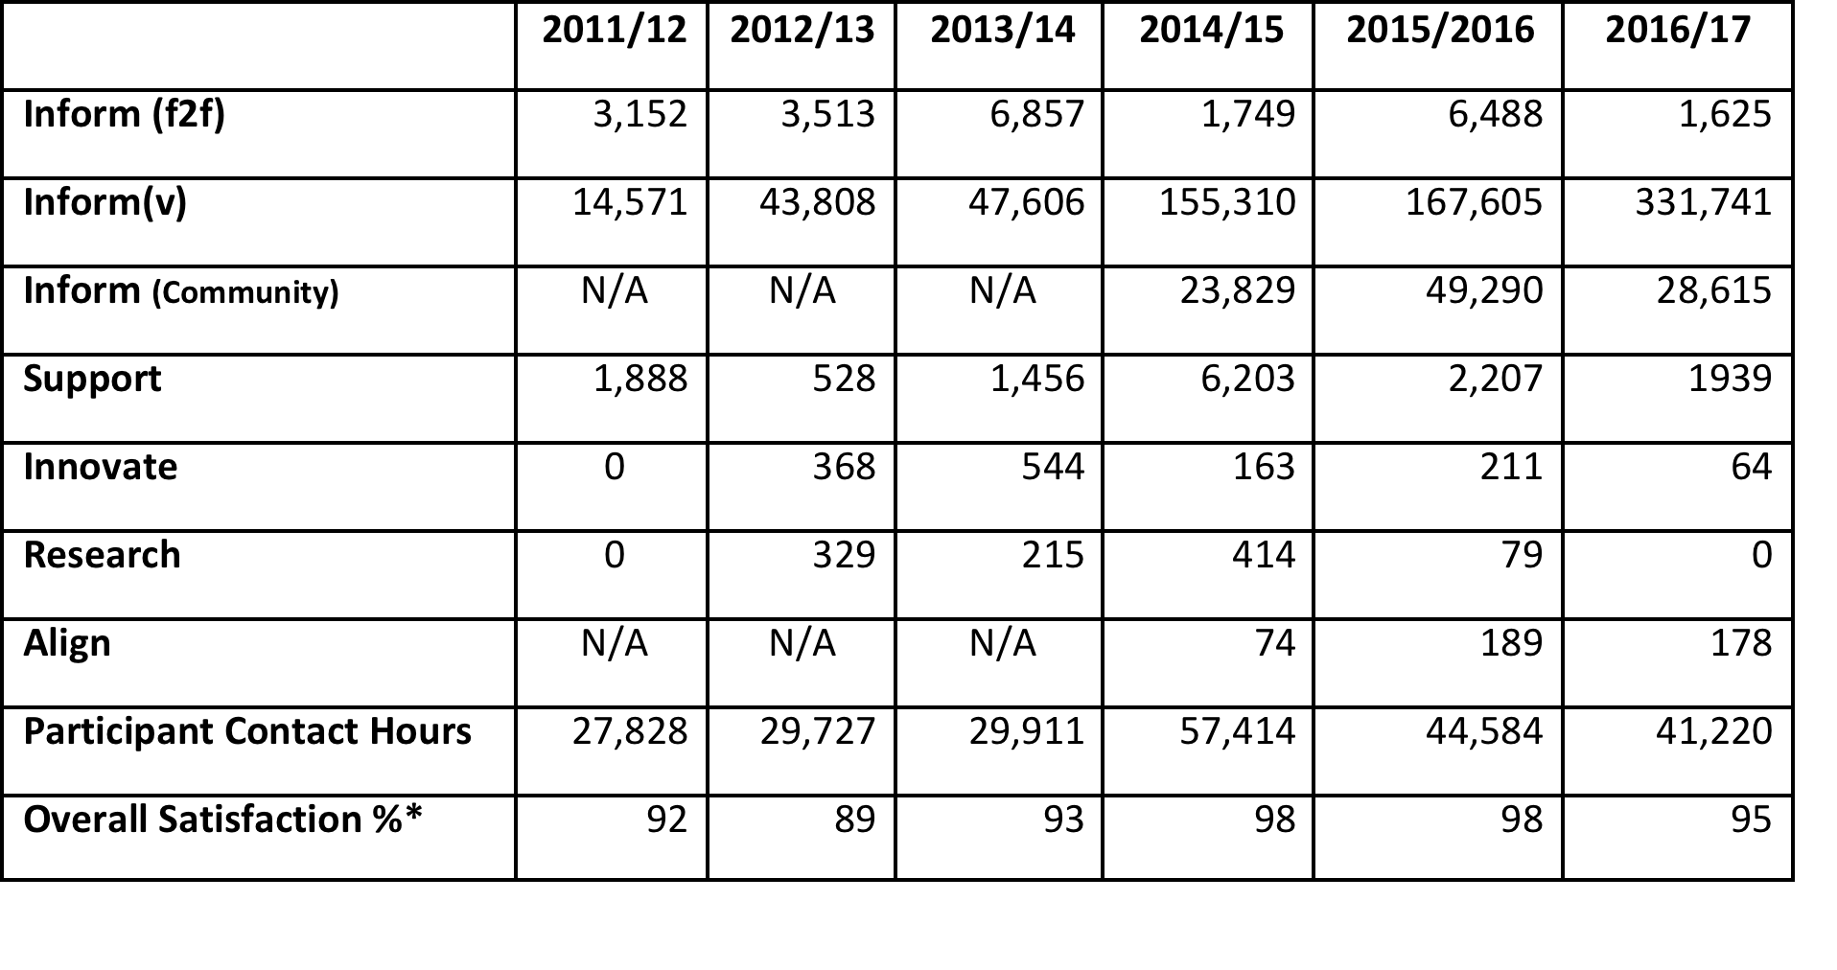
South Carolina’s Statewide STEM Infrastructure - A Longitudinal Look
Notes:
These data represent our impact over the past 5 years as an EIA funded STEM support network. Internally, we evaluate based on how we classify work we do. See Matrix below:
Work that informs tends to be short in duration and intensity. It may also be virtual. For this, we simply count heads…and contact hours. Think community STEM Festivals.
Support work may be short in duration, but is meant to encourage specific action. For this, we assess participant satisfaction. Think professional development day.
Innovate work is where we go deep with participants and expect more significant change in practice. Think multi-day professional learning.
Research work is where we have controls and experimental groups and expect changes in learner outcomes too. Think multi-year professional learning.
Align work identifies who we bring to the effort and what is accomplished as a result. Think community engagement.

Slide 22
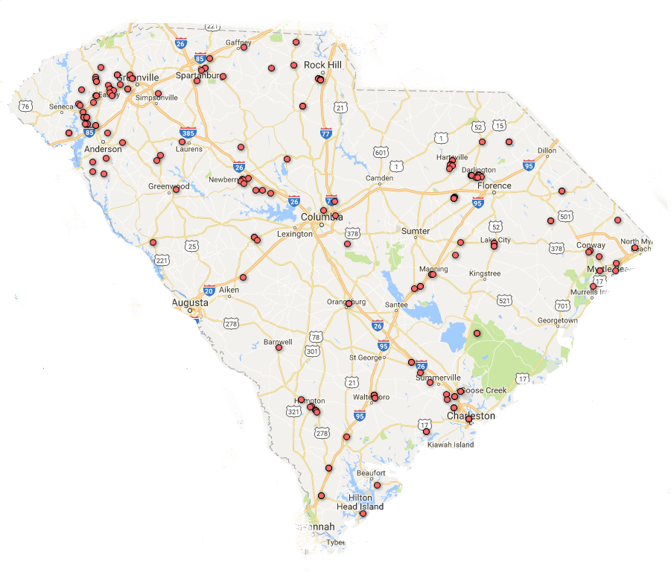
EOC Service Delivery Map:
July 2016 – June 2017
Fewer dots but more long term contracts.
Notes:
Each red dot on the map represents a school, district or other client organization that we provided STEM services to in 2016/17. As compared to 2015/16, there are fewer dots, however, there are more long tem contacts with client organizations.

Slide 23
State Investment
$1,750,000.00
Program Generated Funds
$1,167,703.72
Notes:
SCCMS through its family of affiliated programs and services was able to generate an additional $1.168 million in support of STEM education thanks to the states $1.75 million investment.

Slide 24
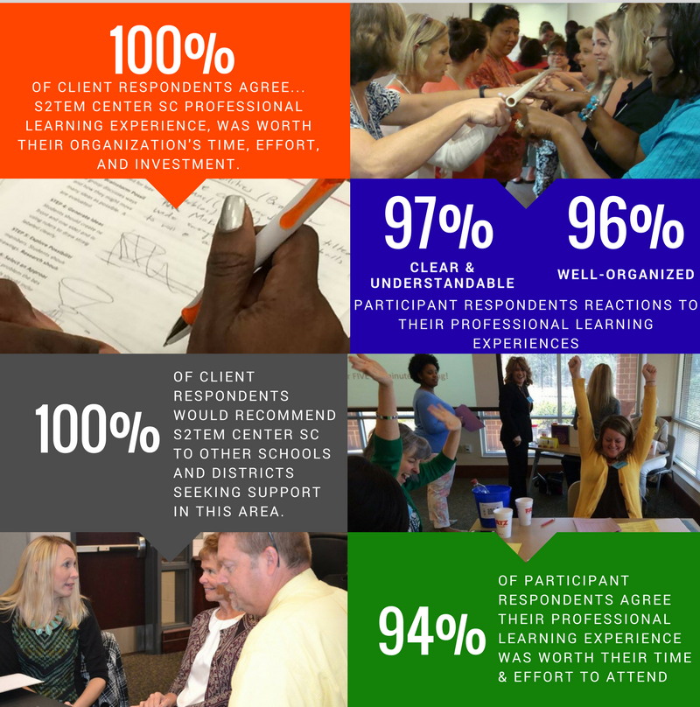
“It provided me the opportunity to begin thinking about how engineering and technology skills can begin at an early age and build knowledge for ‘thinkers’ as they grow.
I am interested in researching and implementing activities in my classroom. Thank you for a very informative session and learning environment.”
Sherry Brownlee, Teacher
Dorchester District 4, Harleyville Elementary
Notes:
These data are generated from aggregated client satisfaction surveys.

Slide 25






SEMI-FINALIST
Notes:
Highlights from 2016/17 include:
Golf for Greenville funding of Science on the Move ($50,000) to purchase a new vehicle and support the program.
SCCMS was recognized as a semi-finalist for the WhatWorksSC award.
SCCMS, SC Afterschool Alliance, and the Smithsonian Science Education Center hosted a national STEM conference in Charleston attended by 300+ persons from 19 states.
SCCMS formed a STEM education partnership with Dreams Imagination Gift, a not for profit serving Williston, SC.
SCCMS and the Midlands S²TEM Center partnered with the Columbia Fireflies to present a STEM festival in conjunction with the total eclipse.
Two S²TEM Centers’ resources (Theory of Action and Innovation Configuration Maps) were endorsed by STEMx after review by a national panel of experts.

Slide 26


NSF INCLUDES DDLP Statewide Consortium: Supporting Underrepresented Populations in Precalculus by Organizational Redesign toward Engineering Diversity
CS For All: RPP: A Scalable RPP for Preparing and Supporting Teachers to Teach Culturally Responsive and Rigorous CS Courses in SC High Schools
Notes:
SCCMS/S²TEM Center SC provide assistance in two NFS funded STEM Education grants at Clemson University.
Boeing has funded a SCCMS/S²TEM Center SC pilot program for computational literacy instruction in middle grades classrooms.

Slide 27

Your Advocacy for…
$90,000 – Education Specialist (Upcountry Region) – To support rural STEM initiatives with particular focus on Lancaster, Chesterfield, Fairfield, and Kershaw Counties. NOTE: this region currently understaffed.
$90,000 – Education Specialist (Coastal Pee Dee Region) - To support rural STEM initiatives with particular focus on the “Pee Dee Public Education Collaborative”.
$45,000 – Community Outreach Associate (Midlands Region) – To support rural STEM initiatives with particular focus on Barnwell, Allendale and Aiken Counties in partnership with Dreams Imagination Gift, a community education program based in Williston.
$25,000 – Technology Updates (all initiatives) – To replace aging computer and other instructional technology tools used by staff across all initiatives.
+$250,000
Notes:
As we look ahead, to what more can be done with a reasonable increase in state funding, we are seeking support for these investments.

Slide 28
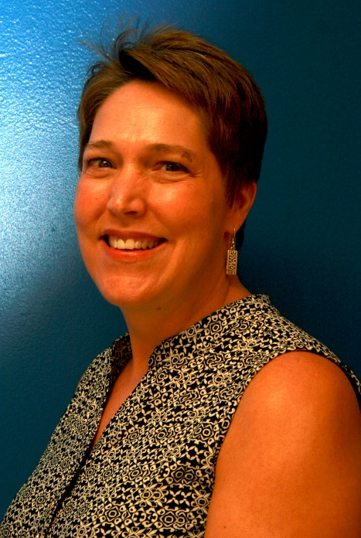

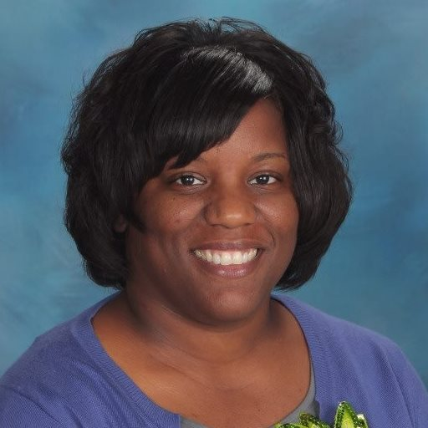
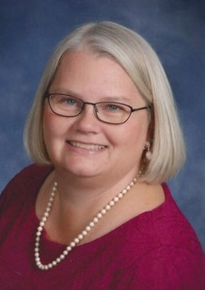
Who is new?
Notes:
We introduced new staff members including:
Pam Brice – Education Specialist, Midlands region
Jomia Mack – Education Specialist, Coastal Pee Dee region
Tracey Campbell – Regional Coordinator, Coastal Pee Dee region
Kelsye Acker – STEM Community Outreach Associate , iMAGINE
Not Pictured
Laura Harper – Program Coordinator, SCCMS
Shelby Williams - STEM Community Outreach Associate , DIG Partnership

Slide 29

Join us on 3.14.18?
Notes:
A day we’ll celebrate the 25th anniversary of our statewide STEM Education network first conceived as the SC Statewide systemic Initiative “Hubs” in 1993.
We are also working on a first launch of a STEM Education Day at the State Capitol. Stay tuned for more!

Slide 30

Greetings From 2018?
Notes:
Still pondering a name and logo change…maybe soon???

Slide 31


Tom Peters, Ed.D.
Executive Director
South Carolina’s Coalition
for Mathematics & Science
tpeters@clemson.edu
864-656-1863
Questions?
Notes:
To carry the conversation forward…

